Slide 1
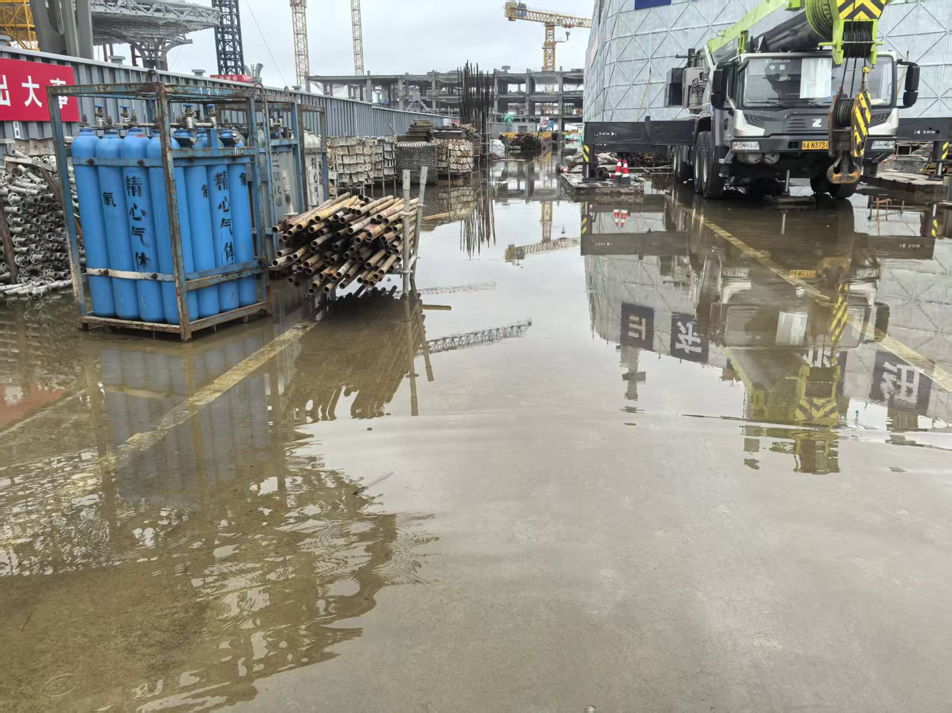
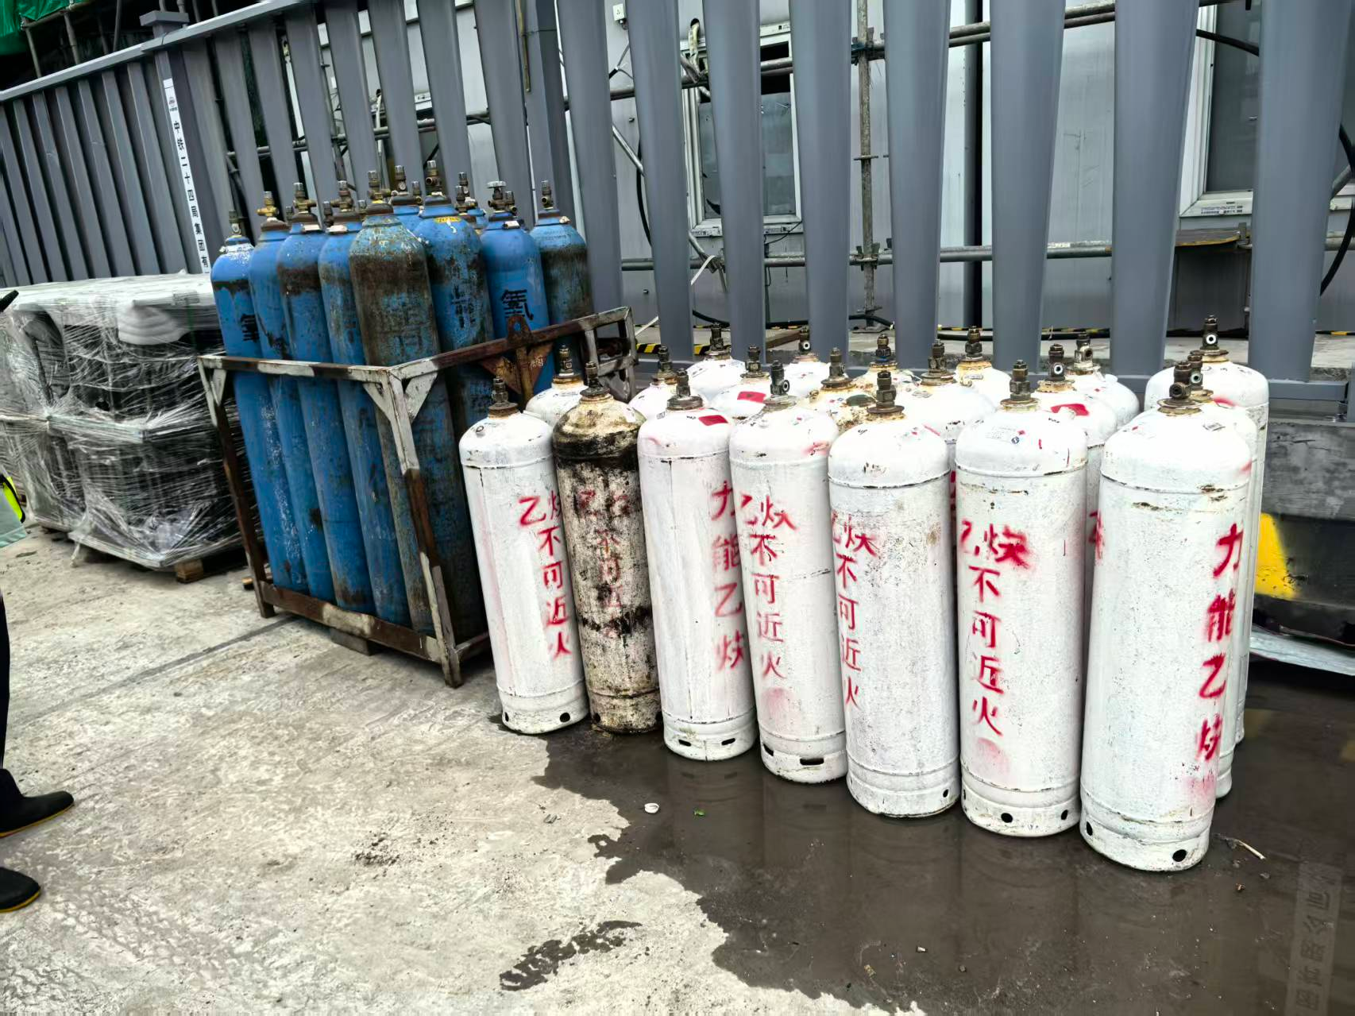
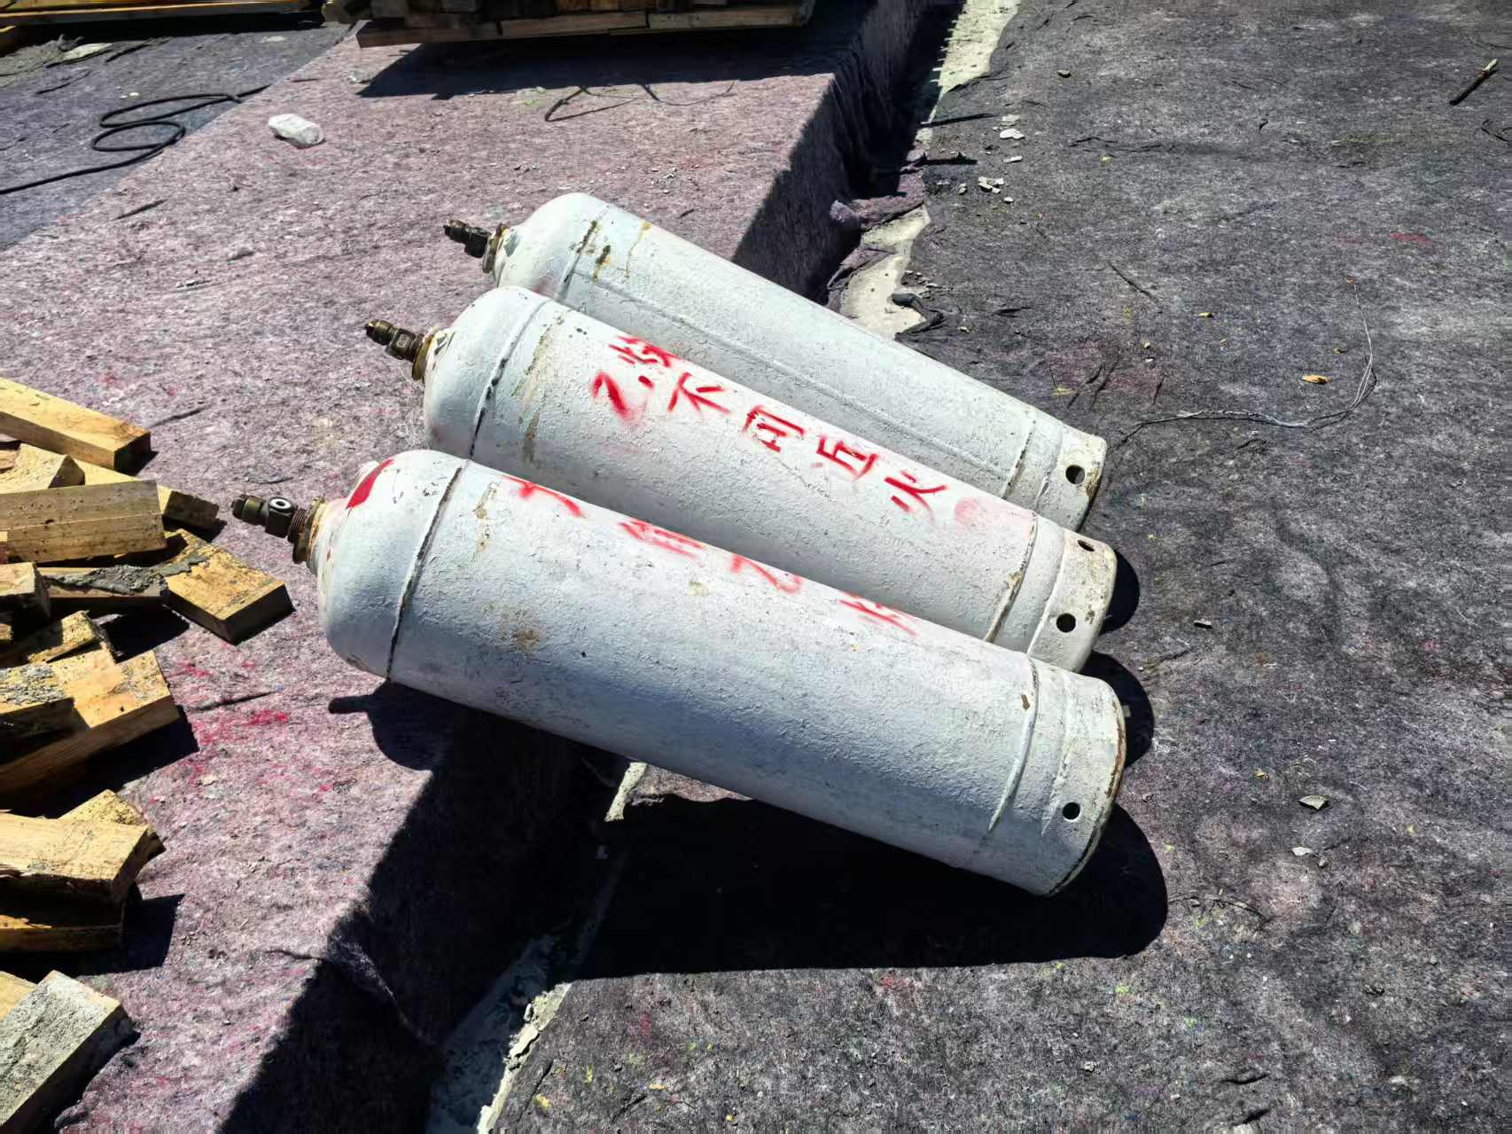
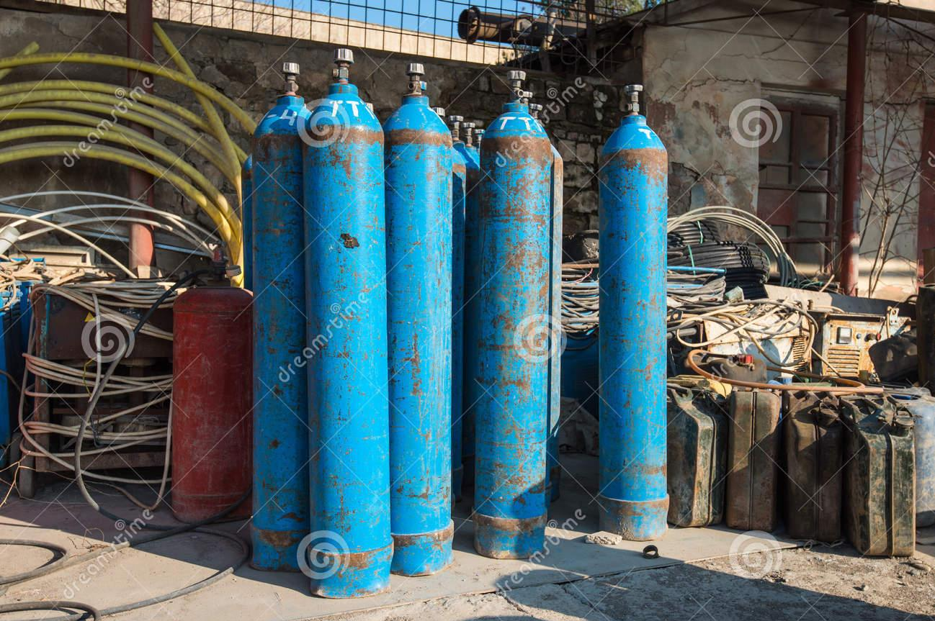
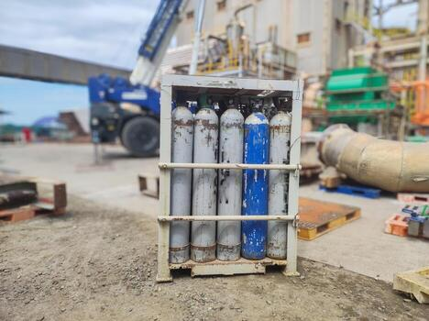
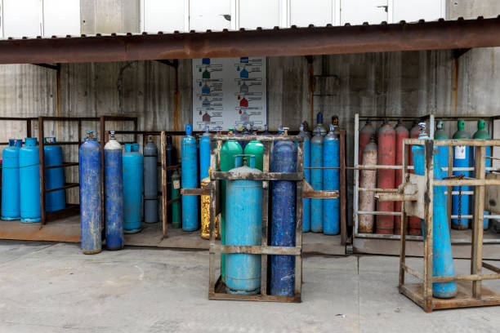
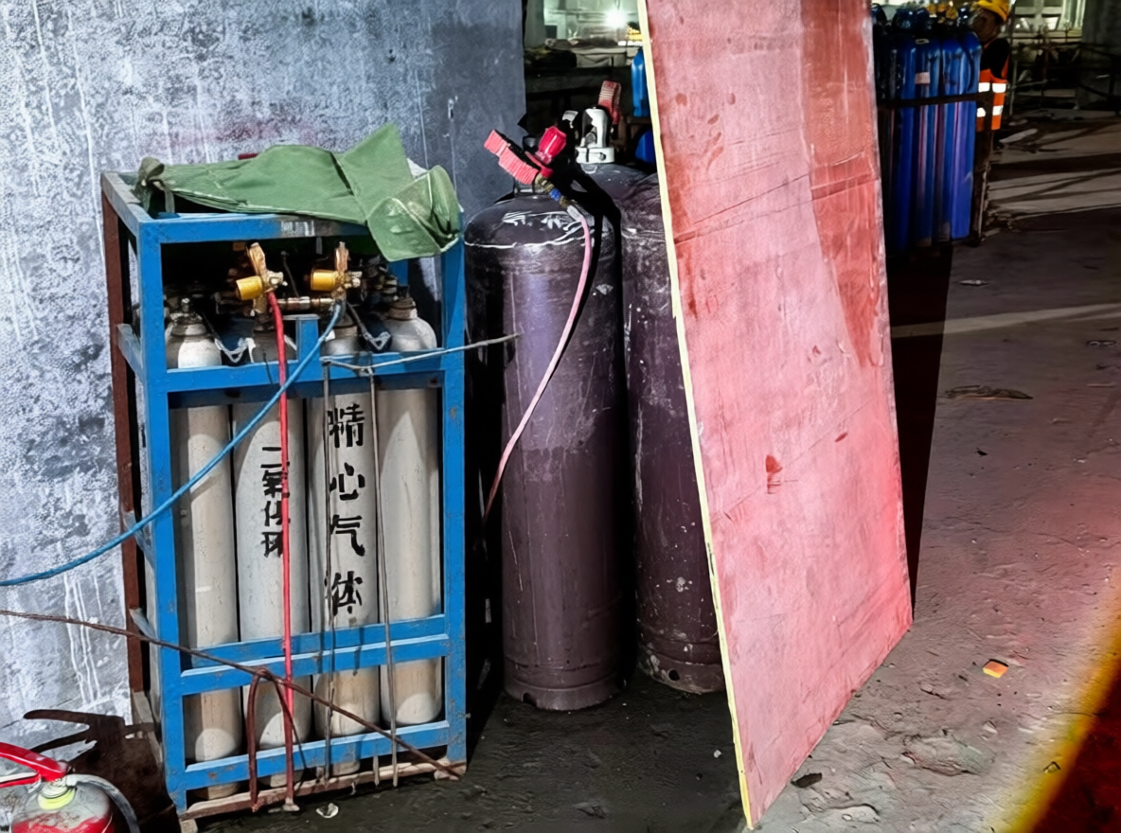
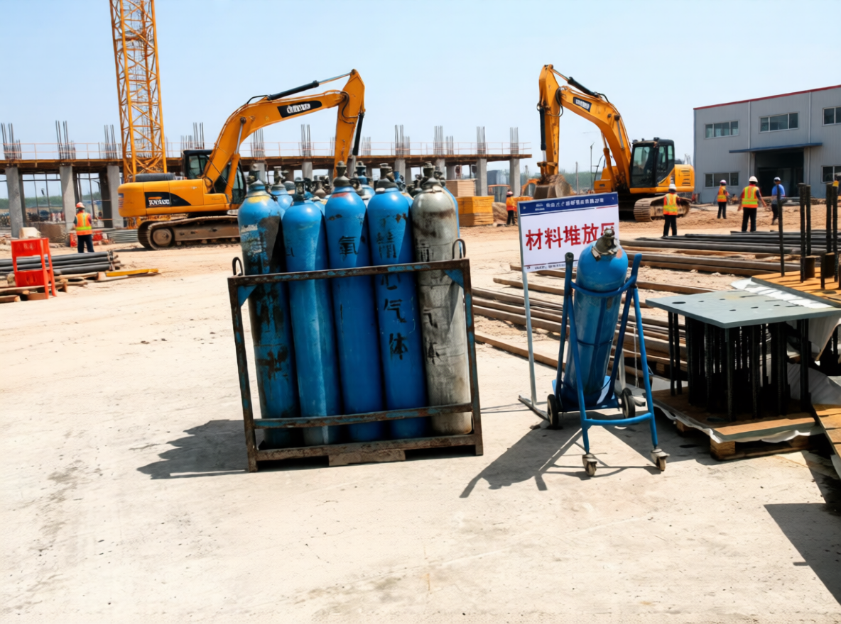
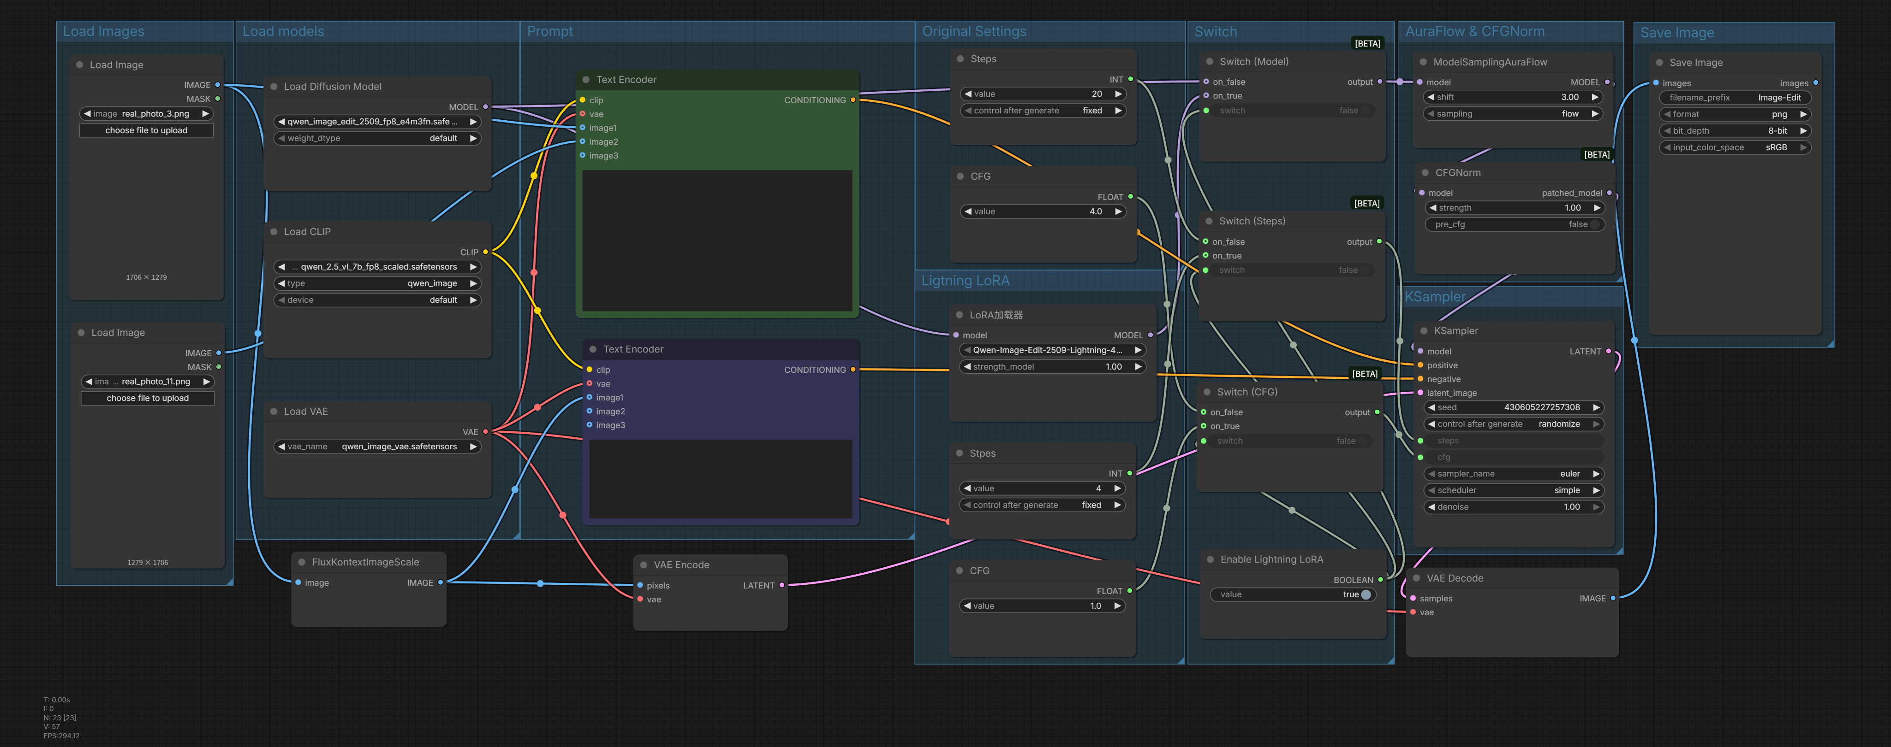
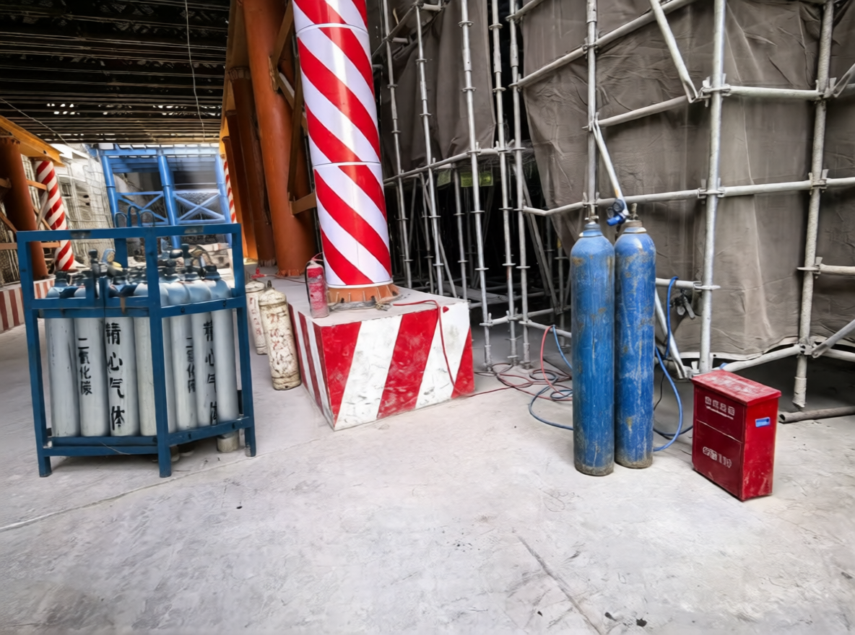
Data Source
Image Edit Workflow
LoRA-based T2I Workflow
Load Image 1
Load Image 2
Load Model
Image Scale &
VAE Encode
Text Encode
Mode Switch
Real-world Images
(On-site Inspection)
Empty Latent
AuraFlow &
CFGNorm
K Sampler
VAE Decode
Real-world Images
(Web-sourced)
Save Image
Synthetic Images
(Image Editing & LoRA-based T2I)

